Slide 1
Study assistant
A Holistic Exam Preparation Platform
Notes:
Are your classroom colors different than what you see in this template? That’s OK! Click on Design -> Variants (the down arrow) -> Pick the color scheme that works for you!
Feel free to change any “You will…” and “I will…” statements to ensure they align with your classroom procedures and rules!

Slide 2

INTRODUCTION
In today's fast-paced world, efficient learning has become more crucial than ever. Juggling notes, videos, and flashcards can be time-consuming and overwhelming. It is a revolutionary tool that streamlines your study process, making it smarter and more effective.

Slide 3
KEY FEATURES
Handwritten notes to digital format.
YouTube video summarization.
Automatic flashcard generation for efficient memorization.

Slide 4

Handwritten Notes to Digital Format
This feature seamlessly transforms handwritten notes into digital format.
Convert them into editable digital text.
Provide multiple export formats (PDF, Word, etc.) for the converted notes, giving users flexibility in how they use and share the digitized content.

Slide 5
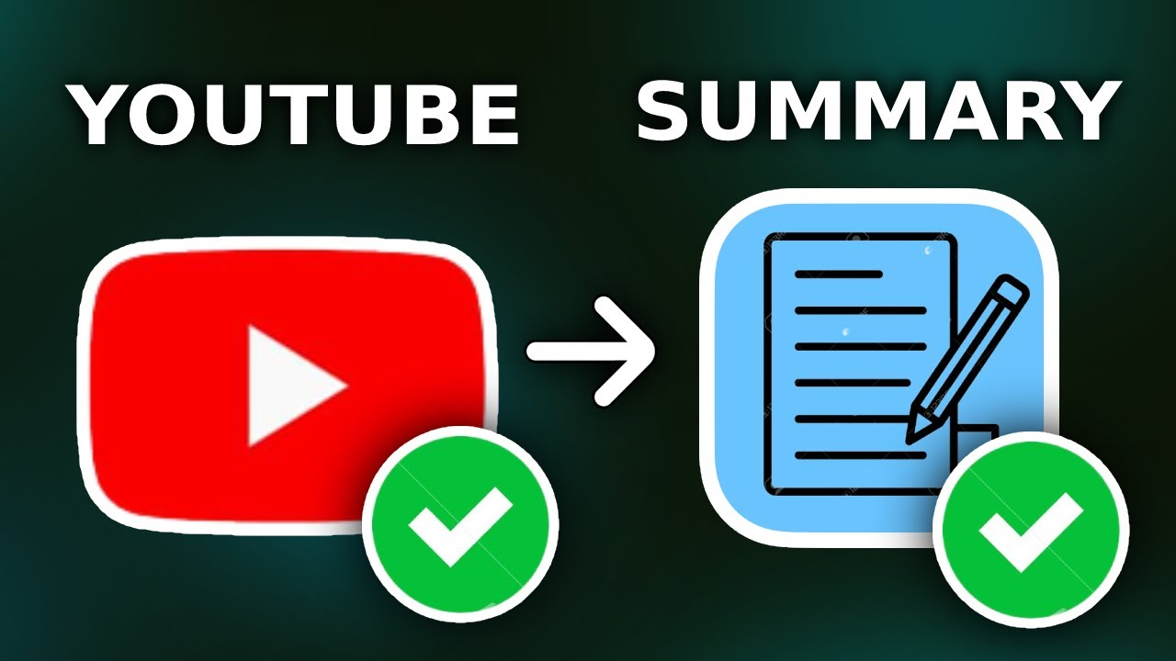
YouTube Video Summarization
Stop struggling to remember key points from lengthy videos.
Simply provide a YouTube link, and our tool generates a concise document summary.
Focus on understanding the concepts, not wasting time taking notes

Slide 6
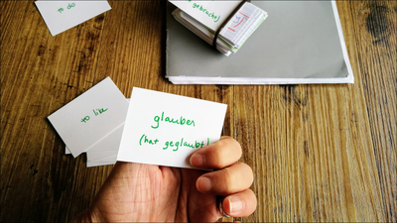
Automatic Flashcard Generation
Upload documents and effortlessly generate flashcards.
Visualize key concepts and information for enhanced recall.
Practice on the go and test your knowledge with interactive flashcards.

Slide 7
CONCLUSION
The culmination of our multifaceted tool results in a myriad of benefits, fundamentally transforming the student learning experience. Enjoy increased study efficiency by seamlessly transitioning between handwritten and digital notes. Our YouTube Video Summarization feature optimizes video learning, making exam preparation more accessible and diverse. The Automatic Flashcard Generation not only saves time but enhances memorization efficiency, turning study materials into personalized, bite-sized review aids.

Slide 8
THANK YOU

